Slide 1
Solicitor Apprenticeships
5-6 year ‘earn as you learn’ programme (how long depends on your previous experience/qualifications)
Paid job while studying at the same time to qualify as a solicitor
Aimed at post A-level students; but post-degree apprenticeship also possible
Cost of training and exams is covered
Notes:
Duration may be reduced if exemptions from training are applicable. Eg
Level 4 Higher Apprenticeship in a relevant occupation - Legal Services, Professional
Services, and Providing Financial Services (may be entitled to exemptions from training);
Paralegal Apprenticeship (may be entitled to exemptions from training);
Legal Executive Apprenticeship (may be entitled to exemptions from training);
Law Degree/ Graduate Diploma in Law / Legal Practice Course (entitled to exemptions from training).

Slide 2
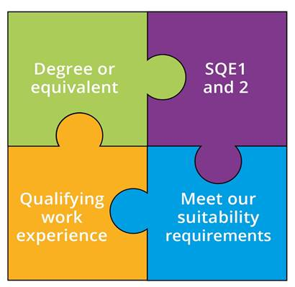
What is the SQE?
New way solicitors will qualify from 1 September 2021
Anyone starting training journey will have to take the new SQE assessments – including apprentices
SQE is not a course – it’s an assessment
Notes:
SQE 2 only after passing SQE 1

Slide 3
What does this means for apprentices?
The degree/equivalent qualification & work experience is covered by your apprenticeship
Take SQE1 during your apprenticeship & SQE2 at the end
Suitability checks when you apply for admission like everyone

Slide 4
SQE1
Functioning Legal Knowledge Assessments
Two 180-question examinations - 10 hours in total
FLK - test ability to identify legal principles and apply them to client problems and transactions
Unflagged ethics questions throughout

Slide 5
SQE2
Practical legal skills assessments
+
16 written and oral tests - 14 hours in total
Simulating tasks carried out by a solicitor in practice
Tests practical legal skills and functioning legal knowledge equally
Unflagged ethics questions throughout

Slide 6
Find out more
sra.org.uk/apprenticeships
Find apprenticeship on the Government website: apprenticeships.gov.uk
Follow us on Facebook and Instagram @careerinlaw

